Slide 1
This can't be a counterexample, can it?
Alternating Series Remainder Theorem
And an AP Question from 1998...
Chris T.

Slide 2

The question and solution
from 1998

Slide 3


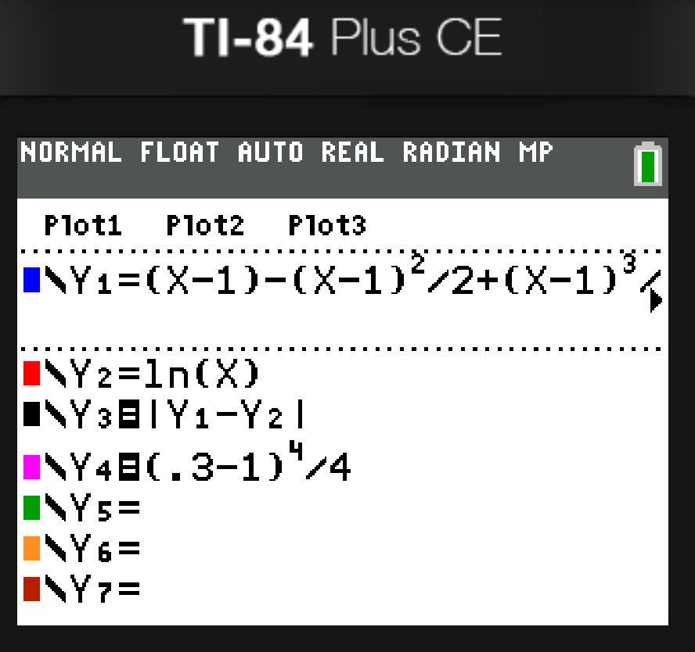
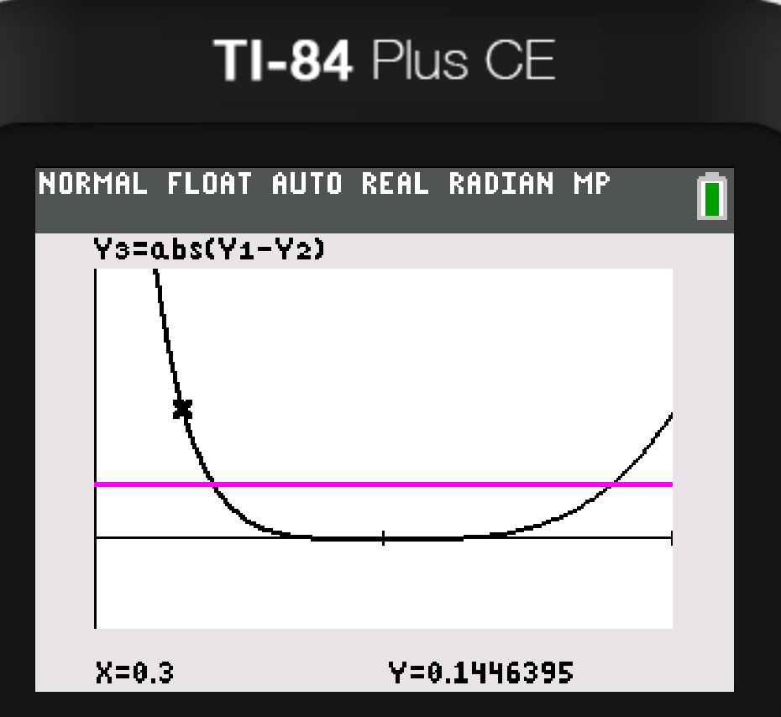

Slide 4

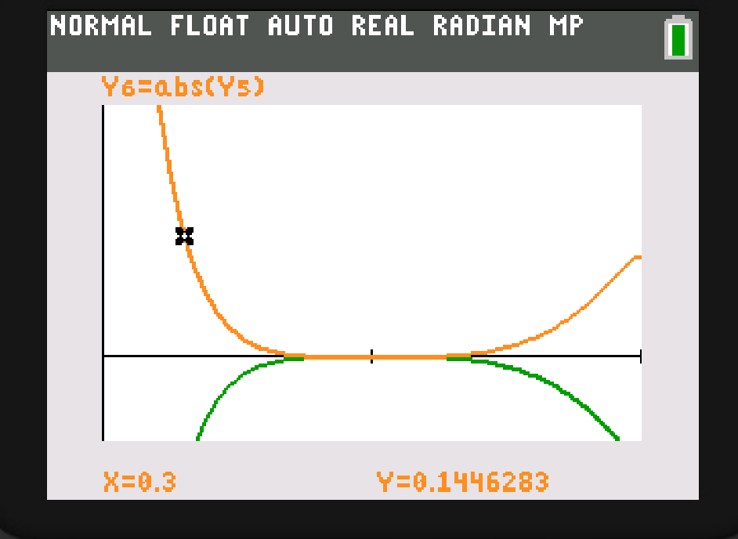

Slide 5


The Alternating Series Theorem
What is an alternating Series?

Slide 6

When will it converge?
The terms are eventually positive
The terms are eventually decreasing
The limit of the nth term is 0.

Slide 7


Alternating Series Remainder
Theorem

Slide 8
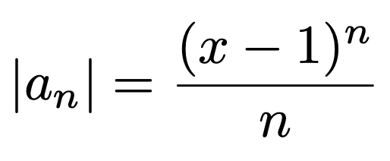



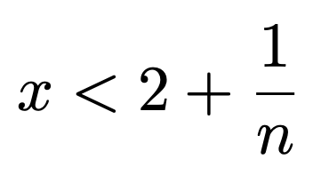

Slide 9





Interval of Convergence
The power service of ln x centered at x = 1 is
The interval of convergence can be shown to be (0, 2]:

Slide 11




The paradox resolved
Sometimes it is not an alternating series,
(so we should uses the Lagrange remainder Theorem instead)!

Slide 12


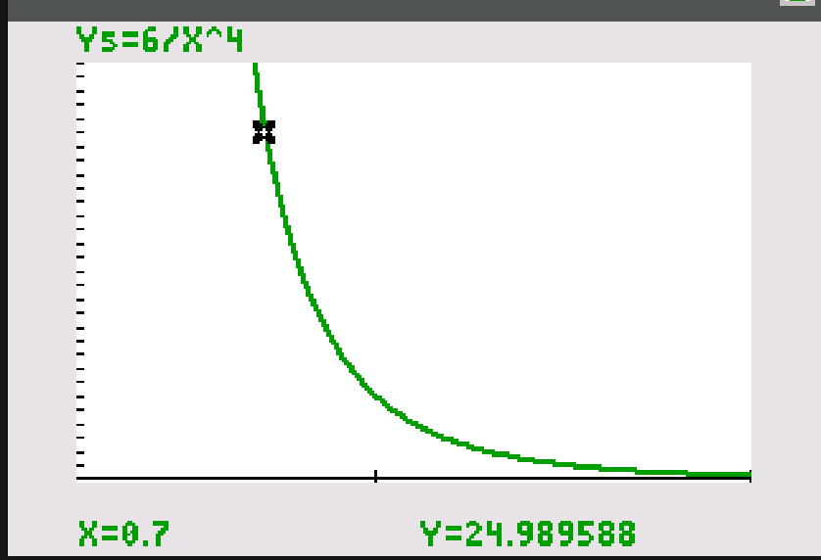


Lagrange form of the Taylor Remainder
Théorie des functions analytiques(1797)
If (n+1) is the first neglected term,

